Slide 1
Personal Finance Manager
Abdulkarim Fattal: 200485312
Isaac Kydd: 200449067
Adai Yisah: 200365751
Week ?
Month Date, Year
Software Engineering Management (ENSE 374)

Slide 2
Agenda
Introduction
Problem Definition
Design Requirements
Solutions
Project Management
Conclusion and Future Work

Slide 3
Introduction
Managing personal finances is increasingly complex due to rising costs and intricate transactions. Existing tools are often too basic or overly complicated for average users.
Our Personal Finance Manager meets the growing demand for intuitive, user-friendly tools by:
Simplifying budgeting and expense tracking.
Providing clear data visualizations and reports.
Enabling engaging goal setting and progress tracking.
Sending helpful email notifications.
This solution makes financial management simple and accessible for everyone.

Slide 4
Problem Definition
Managing personal finances is difficult for many people
Existing tools either offer too little or are too complicated.
Need for a user-friendly solution for expense tracking, budgeting, and goal setting.

Slide 5
Design Requirements
Goals:
Create an easy-to-use personal finance management tool.
Enable budget tracking, goal setting, and financial reporting.
Objectives:
Build an application with an intuitive interface.
Provide simple data entry and basic financial visualizations.
Send notifications and display long-term savings projections.
Constraints:
2-month development timeline. Simplified user experience with no complex features. Ensure privacy and security of user data.

Slide 6
Solution 1
Create Native application and website that would provide all of the aforementioned financial management features
User would create an account on our website. They could then download our application, which would connect to our servers (always requires online), and then decide to either use that or our website.
Pros:
Unique design interface for each type of device provides higher quality UI
Would allow us to reach a very large user-base
Cons:
Incredibly high development time and cost

Slide 7
Solution 2
Create Native application that would provide all of the aforementioned financial management features
User would create an account on our website, then they could download and use the software. The files containing their data would be stored only on their computer.
Pros:
Minimal networking required
Files containing sensitive financial info are incredibly secure
Cons:
Still difficult to develop, requires considerations for multiple operating systems in order to be useful to a wide enough user base
More complicated for the user, would need to never lose file(s) containing all their info
No reliance on our servers means piracy would be easier

Slide 8
Solution 3 (Recommended)
Create purely web-based application that would handle all of the user’s data.
User would make an account on our website, then be given access to the financial tools. Their data would go to and from our server.
Pros:
Relatively easy to develop, reduces cost significantly from previous solutions
Streamlines process for user, does not require any downloads
Does not require any technical knowledge from user (downloading and installing programs can be too technical for many older people, a large part of the potential customer base)
Cons:
Customer’s financial data stored on servers, potentially vulnerable to hackers

Slide 9
 | Usability | Development Time | Features
Solution 1 | 7 | 3 | 8 | 18
Solution 2 | 7 | 5 | 7 | 19
Solution 3 | 6 | 8 | 7 | 21

Slide 10
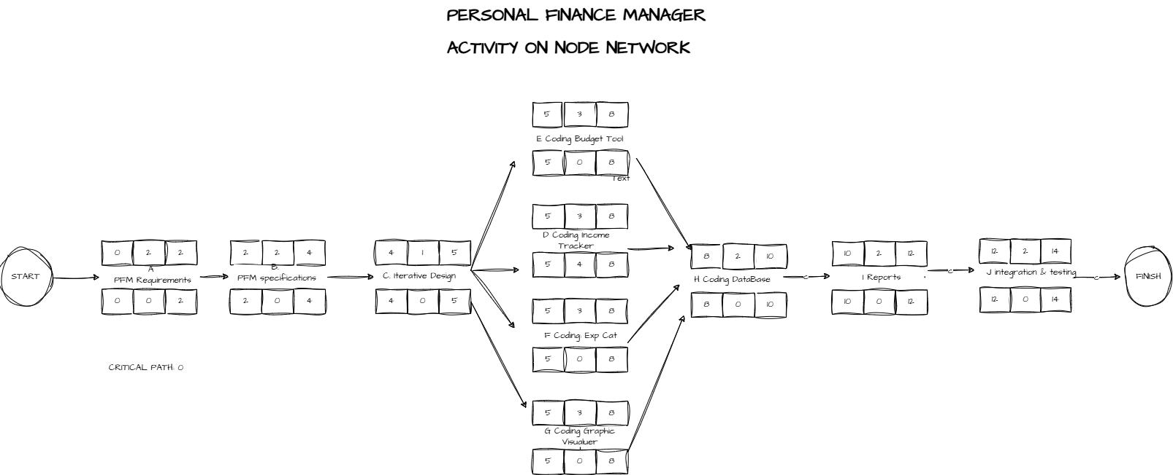
Activity network

Slide 11
What we used
View:
HTML & CSS/Bootstrap
Controller:
Javascript, JQuery
Model:
NodeJS, Express
Database:
MySQL

Slide 12
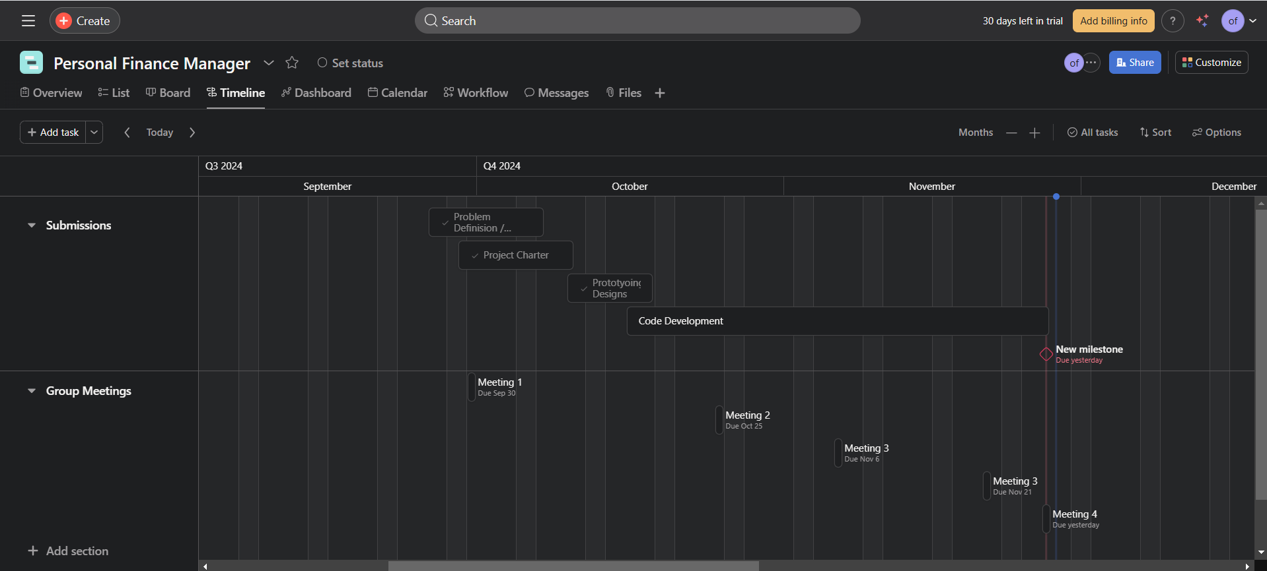
Project Management

Slide 13
Conclusion and Future Work
Conclusion: The Personal Finance Manager offers an easy-to-use solution for managing personal finances with features like budget tracking and goal-setting. It simplifies financial management for users without complex financial knowledge.
Future Work:
Integrate bank account syncing for automatic transaction tracking.
Add personalized financial advice using machine learning.
Develop a mobile app for better accessibility.
Introduce premium features like tax management and investment tracking.

